Slide 1
Final presentation for tourism agency web application
Made by: Nour Eldeen Mohamed, Ramez Nabil, Khaled Nader, Ahmed Mahdy
Supervised by: Dr.Essam Eliwa

Slide 2
System Overview
The client has access to preform functions like booking , reviewing a hotel or a package. Also the client is able to send an inquiry to the support center about a specific hotel or a package or to simply subscribe for the agency’s newsfeed.
The support operator is able to reply to inquires of guests and send the latest news to subscribed guests. Furthermore, the operator can send emails to particular clients in order to follow up on issues or to inform the client of news about the booked package/hotel.
The admin is able to add hotels , packages or edit the main page content and about us page content. Also the admin is able to confirm a reservation of a guest or deny the reservation.

Slide 3
Updates overview
The user is now able to reset his password in case of forgetting it by confirming it through emails sent by the system.
The gallery is now fully functional. Every image throughout the system can be edited, removed or replaced through the admin.
Observer pattern was implemented on the support operator class.
Validations were added to every input field to maintain integrity of the data.

Slide 4
Changes in SRS
Screen captures were updated as the system was updated since last phase.
Functional requirements were updated with the new functions that govern the gallery and password reset.
Updated references.

Slide 5
Changes in SDD
Sequence Diagrams were updated with the proper nomenclature of the classes.
Context diagram was updated with external stimuli.
Added system overview diagram.
Added architecture diagrams for user, admin and support
Updated algorithm viewpoint with several code segments along with authors , dates and screenshots.
Added sequence diagrams for google sign in, user-support interaction, guest booking hotel/package and admin functions.
Added references.
Updated screenshots of the system.

Slide 6
Changes in implementation
Added reset and forgot password functions for the user to be able to reset his password in case it was forgotten.
Added gallery functionality to the admin to be able to control the web application’s images.
Updated observer functionalities to be more precise to the model pattern.
Fixed pricing of the package.
Fixed validations on back-end.

Slide 7
Bugs and defects fixed
In profile page uploading a picture could be any extension .
In profile page defect while editing bank account number.
In profile page defect while editing passport number.
In profile page defect while editing national id number.
In profile page defect while editing mobile number.
In profile page validation on negative values.

Slide 8
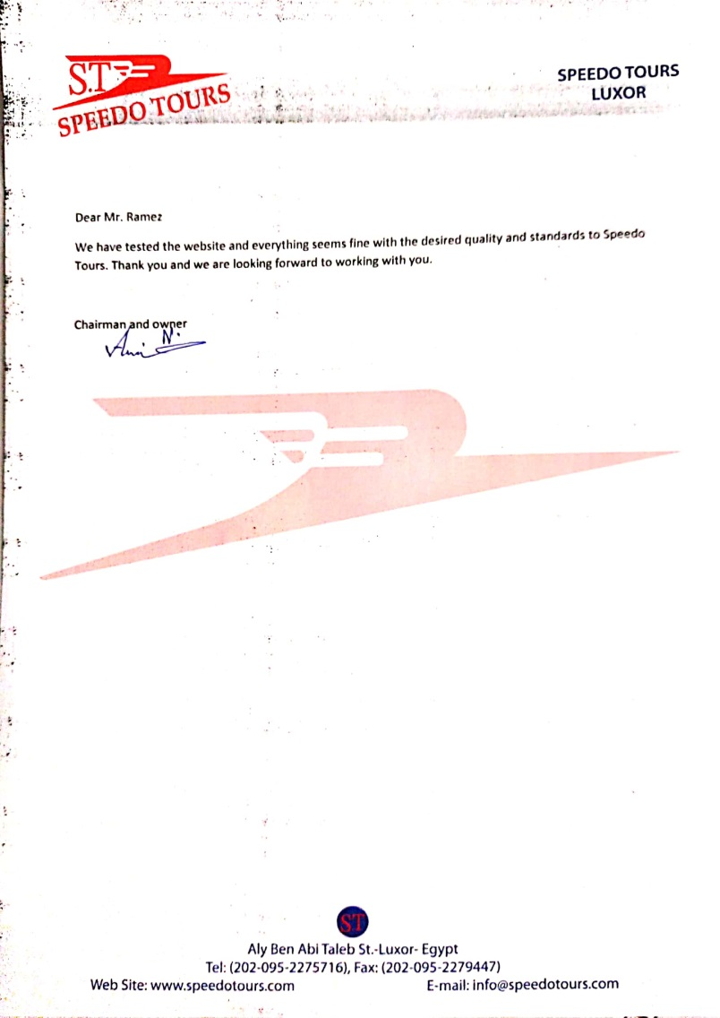
Client acceptance/feedback

